Slide 1
E + I Discussion Group
Diversity in Recruitment
October 1st, 2019
Kelly Wallace and Toby Hammer

Slide 2
Outline
Part 1. Open Forum
Part 2. Actionable Steps for Recruitment
Attract diverse candidates
Prepare a diverse search/admissions committee
Be intentional about the early selection process
Structure the in-person interview process to not discourage certain individuals
Part 3. Revisit the Open Forum

Slide 3
Open Forum
What positive or negative experiences have you experienced or observed in recruitment (grad, postdoc, or faculty level)?
What specific practices, policies, and efforts does UT IB already employ to ensure equitable and diverse recruitment?
Notes:
Add stuff to the board
What ideas / knowledge are we starting with?

Slide 4
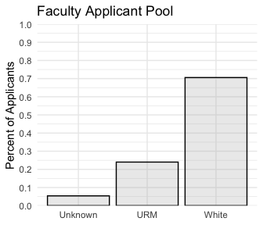
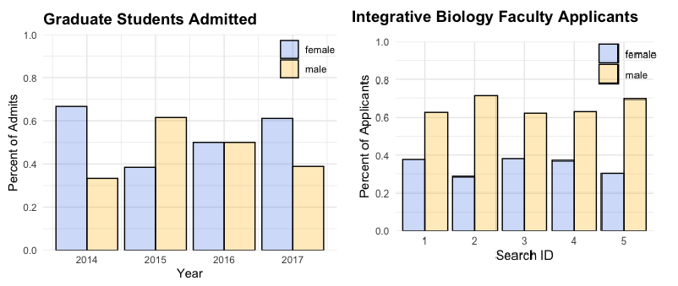
UT Faculty Recruitment
ATTRACT
PREPARE
SELECT
INTERVIEW
Data provided by Marian Schmidt & Julia York

Slide 5
Actionable steps for recruitment: how do we improve?
Equity, Diversity and Inclusion: A Best Practices Guide for Recruitment, Hiring and Retention - Canada Research Chairs
http://www.chairs-chaires.gc.ca/program-programme/equity-equite/best_practices-pratiques_examplaires-eng.aspx

Slide 6
Guideline for best recruitment practices
ATTRACT
PREPARE
SELECT
INTERVIEW
Attract diverse candidates
Prepare a diverse search/admissions committee
Be intentional about the early selection process
Structure the in-person interview process to not discourage certain individuals

Slide 7
Article Breakout
ATTRACT
PREPARE
SELECT
INTERVIEW
“How the opaque way we hire postdocs contributes to science’s diversity problem”
Terry McGlynn

Slide 8
Attract Diverse Candidates
ATTRACT
PREPARE
SELECT
INTERVIEW
Be active, and consider who are you reaching out to...
Post the listings on multiple forms of social media and diversity-focused email lists DiversifyEEB, 500 Women Scientists
Reach out to programs that provide research opportunities to minorities SUPER program (CMB), McNair Scholars, ABS Turner Program
PUI- Primarily Undergraduate Institution
MSI - Minority Serving Institution
HBCU - Historically Black Colleges & Universities

Slide 9
Attract Diverse Candidates
ATTRACT
PREPARE
SELECT
INTERVIEW
In the application/solicitation:
Use gender neutral pronouns
Don’t harp on the word “qualified” (especially don’t use it as a “diversity caveat”)
Require, as part of the job criteria, a track record related to diversity and inclusion.
“Highlight that career interruptions due to parental leave, family care, extended illness, or community responsibilities should not negatively impact the assessment of a candidate’s research productivity. It is important that applicants know these will be taken into consideration when candidates are assessed.” (CRC)

Slide 10
Prepare a Diverse Committee
ATTRACT
PREPARE
SELECT
INTERVIEW
Rule of >1 (have more than one minority committee member)
“If you identify as a member of the majority take responsibility to learn independently about the experiences, perspectives and contributions from non-dominant perspectives (ideally through reading and experience rather than through personal conversations which also require time and energy) and to champion those points of view.” (CRC)
Minimize risk associated with participation.

Slide 11
Prepare a Diverse Committee
ATTRACT
PREPARE
SELECT
INTERVIEW
Attend to group dynamics. Repeat and emphasize the opinions and ideas of minorities in the committee.
“Suspend disbelief. Marginalized viewpoints can often be hard to hear or understand for people who have not been exposed to particular perspectives before. They often are not taken at face value, but are justified and explained away.” (CRC)
Spend some time as a committee researching topics like unconscious bias, and perhaps take one or two implicit association tests beforehand (https://implicit.harvard.edu/implicit/takeatest.html)

Slide 12
Be intentional about the early selection process
ATTRACT
PREPARE
SELECT
INTERVIEW
Become familiar with minority-based fellowships and opportunities.
If the pool of applicants to the posting is not large or diverse enough, extend the application deadline, or review the ad more critically for potential barriers and repost it.

Slide 13
Be intentional about the early selection process
ATTRACT
PREPARE
SELECT
INTERVIEW
Acknowledge that letters of recommendation are biased 16% longer for male trainees.
“Research has shown that assessors are more likely to use “grindstone adjectives” (e.g., “hardworking,” “diligent,” “conscientious”) to describe women, and to reference these candidates’ personal lives, while they are more likely to use “stand-out” adjectives (e.g., “outstanding,” “superb,” “excellent”) to describe men, and to reference their CV, publications or patents.” (CRC)

Slide 14
Be intentional about the early selection process
ATTRACT
PREPARE
SELECT
INTERVIEW
Don’t focus solely on a strong publication record, to the exclusion of other aspects, including non-traditional areas of research and/or research outputs.
Critically evaluate if a candidate’s standardized test scores, grades, etc. are likely to accurately predict their ability to succeed in grad school (e.g. GPA, SAT, GRE)

Slide 15
The GRE as one potential barrier to inclusive grad student recruitment
ATTRACT
PREPARE
SELECT
INTERVIEW
Test taking and prep is a significant barrier for students with less time and fewer resources
Evidence that GRE scores actually predict success in grad school is mixed and controversial
GRE scores often biased in favor of white males from wealthier socioeconomic backgrounds (e.g., Miller & Stassun, Nature 2014)
>250 grad programs have dropped the GRE; e.g. ecology/evolution/IB/Biology departments at U Chicago, Yale, Berkeley, Harvard, U Michigan, U Penn, UW, UCLA, U Oregon, U Colorado, Princeton, Wash U, etc.
At the least, many people (including ETS) recommend against using poor GRE scores to quickly filter out applicants
Notes:
“research by ETS indicates that the predictive validity of the GRE tests is limited to first-year graduate-course grades, and even that correlation is meagre in maths-intensive STEM fields.”
students may eventually avoid applying to GRE-requiring programs altogether
https://docs.google.com/spreadsheets/d/1MYcxZMhf97H5Uxr2Y7XndHn6eEC5oO8XWQi2PU5jLxQ/edit#gid=0

Slide 16
Article Breakout
ATTRACT
PREPARE
SELECT
INTERVIEW
“If there’s only one woman in your candidate pool, there’s statistically no chance she’ll be hired”
Prof. Stefanie Johnson, David Hekman, & Elsa Chan

Slide 17
Structure the in-person interview process to not discourage certain individuals
ATTRACT
PREPARE
SELECT
INTERVIEW
Ensure all candidates receive the same tailoring of visits (speaking with specific people, seeing certain resources, etc)
Grad Recruitment alternative events- (EEB Grad Recruitment is early february!)
Have plans/resources available for those unable to attend recruitment weekend
Have an anonymous exit survey to evaluate grad/faculty interview/visit experience

Slide 18
Open Forum - Action Items for this department
What actions or ideas from the previous slides could IB use to improve equity and diversity in recruitment?
EEB Graduate Admissions Chair- Misha Matz
IB Department Chair - Claus Wilke
Faculty Search Chair for Evolutionary Genomics - Bob Jansen
Notes:
(or other things not on the slides)

Slide 20
(Optional if time? How retention and promotion efforts affect recruitment efforts)
Differences between recruitment and retention; how improving retention in the dept can benefit recruitment
Systematically collect self-identification data at all levels of faculty.
Ask faculty, staff and students of every background and ability about the institution’s collegiality and climate and how well it is doing in its equity, diversity and inclusion work.
Put a candidate’s teaching evaluations in context.

Slide 21
Why is recruiting diverse students/postdocs/faculty important?
Because there are always many ways in which a particular topic can be viewed, diverse perspectives are needed to gain comprehensive understanding.
Bias reduces our ability to hear and learn from new-to-us perspectives
diversity does NOT sacrifice quality or merit good grief people
Representation
Notes:
I think we can probably skip this as it should be self-evident to the group by this point...

Slide 22
Why is recruiting diverse students/postdocs/faculty important?
Are there members of underrepresented groups in senior leadership and research roles in our organization?
How have role models influenced you?
Are there members of underrepresented groups acting as mentors for faculty and students?
How does your organization recognize E&I efforts and achievements?
When in a recruitment process are marginalized views most needed?
Notes:
What about brief group discussion of interview / application / recruitment processes we have gone through, experiences to share? Anything in particular about process that stood out for helping or hurting recruitment ?

Slide 23
Common biases in recruitment
Remember the rule of >1.
• Suspend disbelief. Marginalized viewpoints can often be hard to hear or understand for people who have not been exposed to particular perspectives before. They often are not taken at face value, but are justified and explained away.

Slide 24
Reading/stats
Johnson et al. Harvard Business Review? (https://www.researchgate.net/profile/David_Hekman3/publication/303003812_If_There's_Only_One_Woman_in_Your_Candidate_Pool_There's_Statistically_No_Chance_She'll_Be_Hired/links/575eea9908ae9a9c955f8e2c/If-Theres-Only-One-Woman-in-Your-Candidate-Pool-Theres-Statistically-No-Chance-Shell-Be-Hired.pdf)
Postdoc recruitment article

